Slide 1
Role-play on EU decision-making https://www.youtube.com/watch?v=zHjILxl9E6U

Slide 2
European Union: 27 countries

Slide 3
Population in millions (2024) 449 million in total

Slide 4
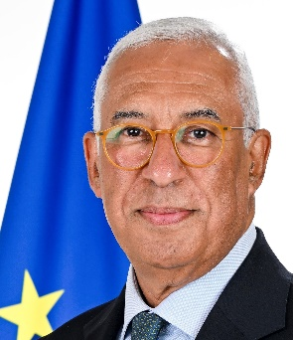
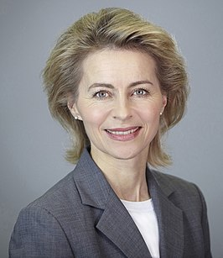
Three Presidents:
Roberta Metsola European Parliament
António Costa European Council
Ursula von der Leyen
European Commission

Slide 5
The EU institutions institutions
European Council (summit)
European Parliament
Council of Ministers
(The Council)
European Commission
Court of Justice
Court of Auditors
Economic and Social Committee
Committee of the Regions
European Investment Bank
Agencies
European Central Bank

Slide 6
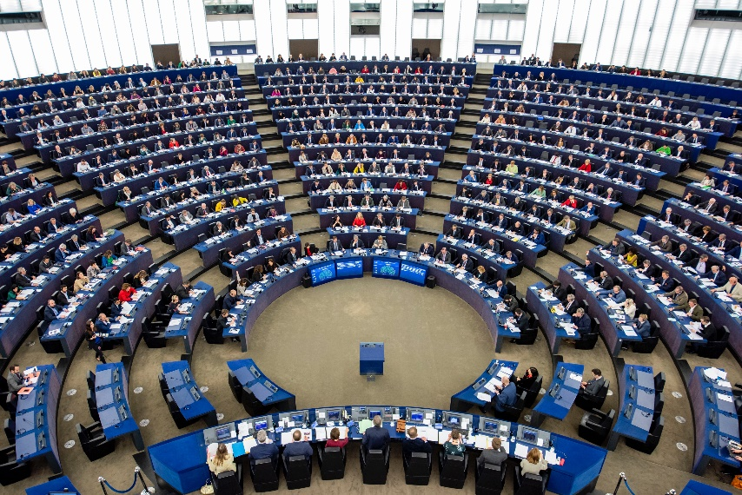
The European Parliament – voice of the people
4 Decides EU laws and budget together with Council of Ministers 4 Democratic supervision of all the EU’s work
4 The European Parliament is made up of 720 Members
4 Elections every five years (2024-2029)

Slide 7
Council of Ministers – voice of the Member States
4One minister from each EU country 4Presidency: rotates every six months 4Decides EU laws and budget together with Parliament 4Manages the common foreign and security policy

Slide 8
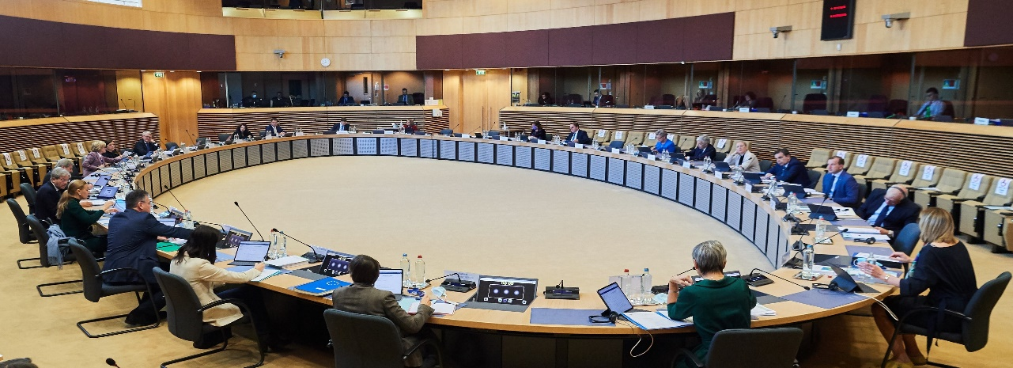
The European Commission – promoting the common interest
27 independent members, one from each EU country 4Proposes new legislation 4Executive organ
4Guardian of the treaties
4Represents the EU on the international stage

Slide 9
How EU laws are made
Citizens, interest groups, experts: discuss, consult
Commission: makes formal proposal
Parliament and Council of Ministers: decide jointly
National or local authorities: implement
Commission and Court of Justice: monitor implementation

Slide 10
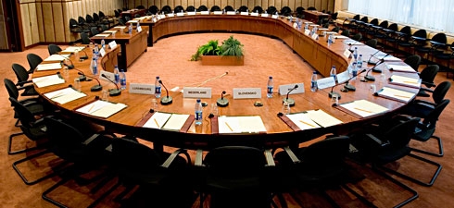
Role-play
EU decision-making

Slide 11
Problem European Commission: Difference in chocolate production between countries: cocoa butter vs. other vegetable fats Chocolate that contains vegetable fats that do not originate from cocoa, is not allowed to be called ‘chocolate’ in some countries and may therefore not be sold in these countries.
EU Internal Market : free movement of goods

Slide 12
- Companies from Member States are allowed to make chocolate with other vegetable fats (meaning: they may replace cocoa butter) - Member States must allow chocolate in their market that contains other vegetable fats than cocoa butter (meaning: they may sell chocolate with other ingredients in other Member States and still call it chocolate)
EC proposal for a Chocolate Directive

Slide 13
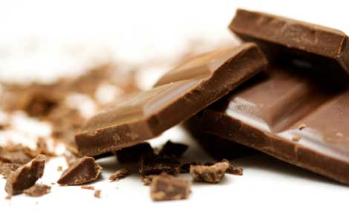
You will now receive briefings - please take a few minutes to read them. Good luck!

